Slide 1
Air Freight
State of the Market Webinar
March 2023

Slide 2



300m+
rates used for calculation
160k+
Our mission is to drive your
business success by leveraging the
world’s largest real-time, independent database
of ocean and air freight rates.
port to port pairs
10m+
new rates per month
40k+
airport to airport pairs
Xeneta has more temperature-controlled BCO rate data than any other air freight rate provider in the market.
Crowdsourced from our customers

Slide 3
Year-on-year air cargo rate continued to stabilize in February
Global air cargo volume, capacity, load factor and rate developments
    vs 2019
Chargeable weight (% change)
Capacity (% change)
    YoY
0
    -5
    -4
    -8
    -10
    -8
    Feb 2022
    Mar
    Apr
    May
    Jun
    Jul
    Aug
    Sep
    Oct
    Nov
    Dec
    Jan 2023
    Feb
    Feb 2022
    Mar
    Apr
    May
    Jun
    Jul
    Aug
    Sep
    Oct
    Nov
    Dec
    Jan 2023
    Feb
Dynamic load factor (% points change)
Rates (% change)
    DLF
    57%
    Feb 2022
    Mar
    Apr
    May
    Jun
    Jul
    Aug
    Sep
    Oct
    Nov
    Dec
    Jan 2023
    Feb
    Feb 2022
    Mar
    Apr
    May
    Jun
    Jul
    Aug
    Sep
    Oct
    Nov
    Dec
    Jan 2023
    Feb
Source: CLIVE Data Services, now part of Xeneta

Slide 4
Load factors Y-o-Y declined across nearly all corridors, except Africa
February 2023 dynamic load factor for regional flows
(Weeks 5-8 of 2023 compared to similar weeks in 2022)
Source: CLIVE Data Services, now part of Xeneta
Notes:
LF from Europe to NA (Nov 72%; Dec 71%; Jan 65%; Feb 71%).
LF from APAC to Europe (Nov 81%; Dec 78%; Jan 77%; Feb 74%).
APAC to NA (Nov 84%; Dec 87%; Jan 77%: Feb 79%).
LATAM to NA (Nov 79%; Dec 67%; Jan 66%; Feb 67%).

Slide 5
Main fronthaul air cargo rates remain elevated compared to 2019
Average airline spot air cargo rates in February 2023 vs 2019 on top corridors (USD per kg)
    Feb 2019
    Feb 2023
    Feb 2023 vs 2019
    +73%
    China to North America
    Northeast Asia (excl China)
    to Europe
    +93%
    4.75
    Northeast Asia (excl China)
    to North America
    +42%
    +80%
    China to Europe
    3.93
    Southeast Asia
    to North America
    +18%
    3.70
    +42%
    Europe to North America
    2.88
    Southeast Asia
    to Europe
    +38%
    2.68
Source: CLIVE Data Services, now part of Xeneta

Slide 6
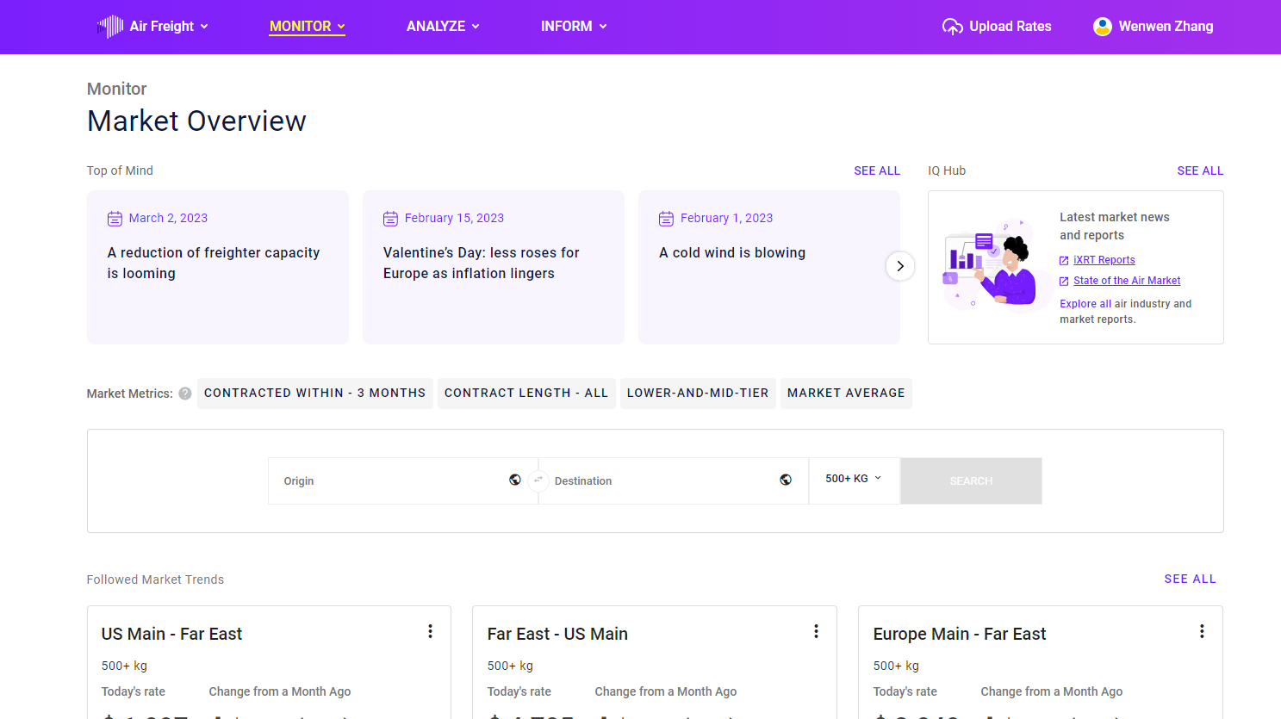

Slide 7
The upcoming summer season is set to welcome more capacity
Airline global capacity index for freighter flights
(Freighter capacity 2019 = index 100)
Airline global capacity index for passenger flights
(Passenger belly capacity 2019 = index 100)
+10%
+4%
2018 Winter
2019 Summer
2019 Winter
2020 Summer
2020 Winter
2021 Summer
2021 Winter
2022 Summer
2022 Winter*
2018 Winter
2019 Summer
2019 Winter
2020 Summer
2020 Winter
2021 Summer
2021 Winter
2022 Summer
2022 Winter*
* 2022 winter season up until 26 February 2023
Source: CLIVE Data Services, now part of Xeneta
Notes:
What it means for contract negotiation for upcoming contracts

Slide 8
Global air freight rate spreads remained widened since pandemic
The spread of global air freight mid-low and mid-high rates from airlines, USD per kg
(Mid-low: the rate at which 25% of market rates falls below; Mid-high: the rate at which 75% of market rates falls below)
Mid-High
Feb: 4.48
Feb: 3.01
Feb: 2.08
Mid-Low
Jan 19
Mar 19
May 19
Jul 19
Sep 19
Nov 19
Jan 20
Mar 20
May 20
Jul 20
Sep 20
Nov 20
Jan 21
Mar 21
May 21
Jul 21
Sep 21
Nov 21
Jan 22
Mar 22
May 22
Jul 22
Sep 22
Nov 22
Jan 23
Feb 23
Source: CLIVE Data Services, now part of Xeneta

Slide 9
Thanks!
DISCLAIMER
The content in this webinar is provided for general information purposes only and participants should not construe any information or discussion or contained therein as personalized advice. Participants are encouraged to do their own research.
Although Xeneta has made reasonable efforts to update the information in this webinar on the date it is released, Xeneta makes no representations, warranties or guarantees, whether expressed or implied, that the content of this webinar is accurate, complete or up to date. Xeneta expressly disclaims any liability for any decision made or action taken in reliance on the information contained in this webinar.
The views expressed by any speakers or other third parties during webinars held by Xeneta are those of the speaker or third-party and not, necessarily, of Xeneta.
Reproduction, distribution, republication, and/or retransmission of this presentation and any related material without Xeneta’s prior written approval is strictly prohibited.

Slide 10
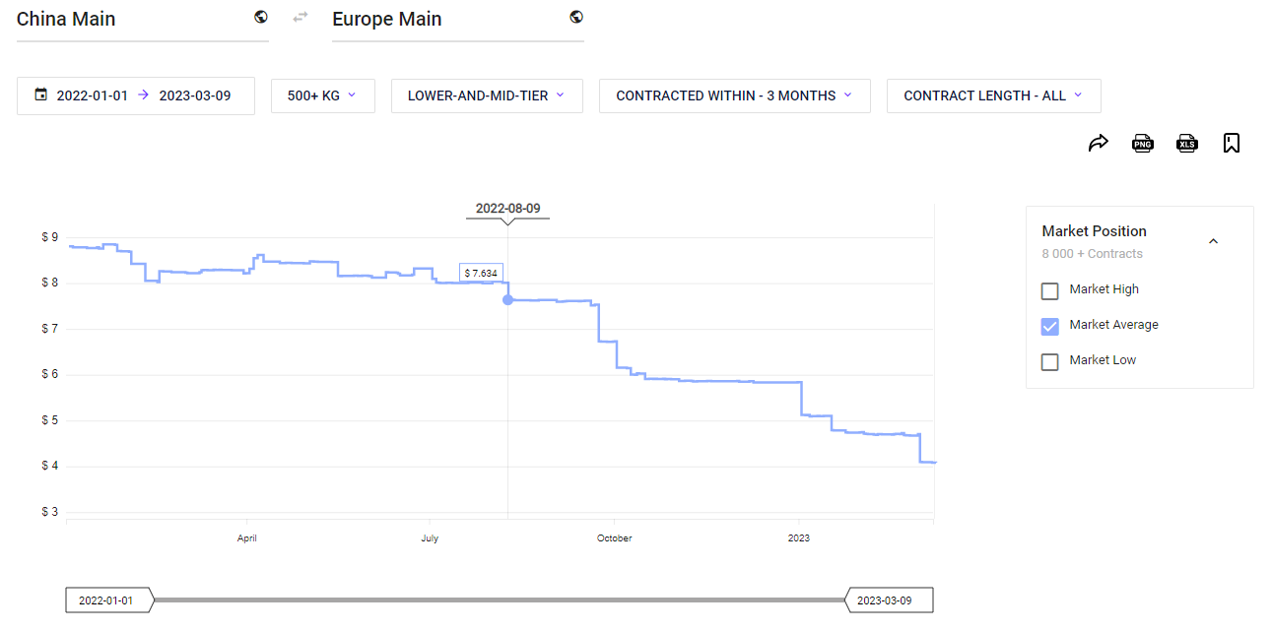
Trade Lane - Benchmarks | Xeneta
Source: CLIVE Data Services, now part of Xeneta
Notes:
NOTE this is the average of short and long term contract rates.

Slide 11
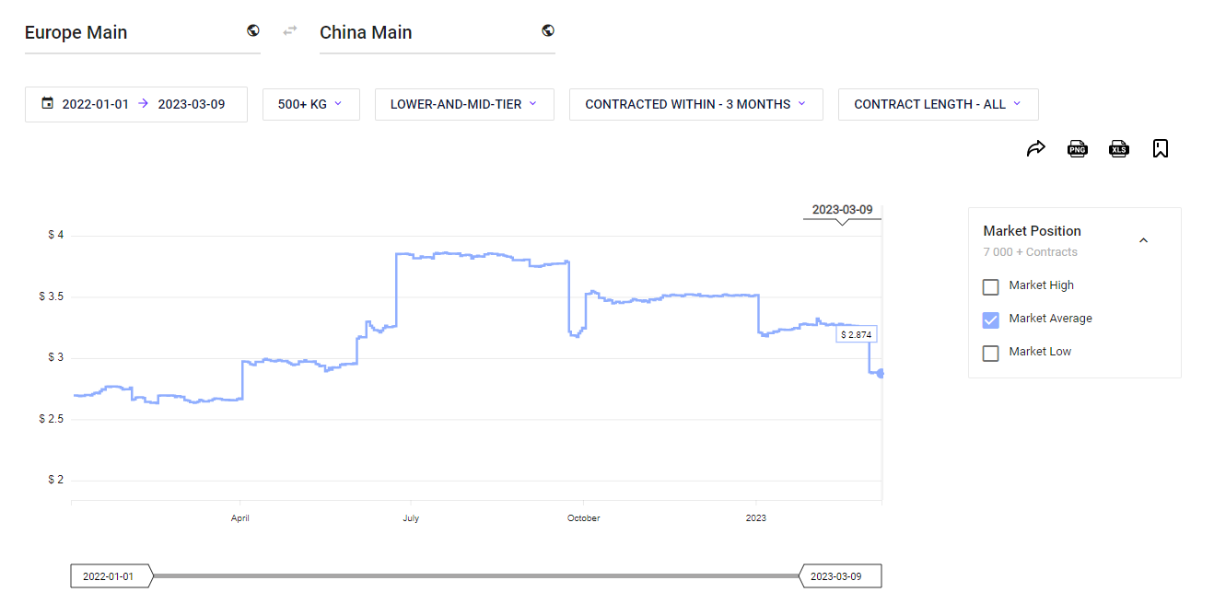
Trade Lane - Benchmarks | Xeneta
Source: CLIVE Data Services, now part of Xeneta

